Slide 1
UML

Slide 2
What is UML
Unified Modeling Language
OMG Standard, Object Management Group
Based on work from Booch, Rumbaugh, Jacobson
UML is a modeling language to express and design documents, software
Useful for OO design
Not a process, but some been proposed using UML
Independent of implementation language

Slide 3
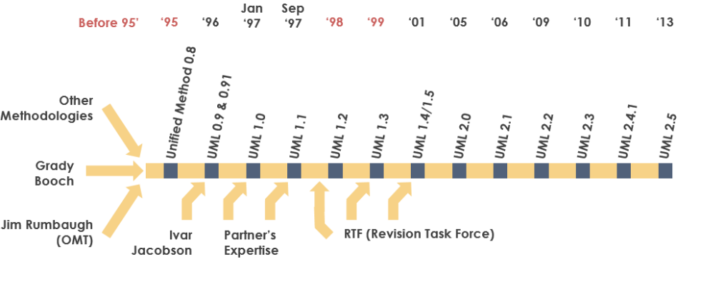
Why use UML
Open Standard, Graphical notation for
Specifying, visualizing, constucting, and documenting software system
Increase undrestanding/communication of product to customers and developers
History of the UML
https://www.uml-diagrams.org/
https://www.visual-paradigm.com/guide/uml-unified-modeling-language/what-is-uml/

Slide 4
UML Baseline
Use Case Diagrams
Class Diagrams
Package Diagrams
Interaction Diagrams
Sequence
Collaboration
Activity Diagrams
State Transition Diagrams
Deployment Diagrams

Slide 5
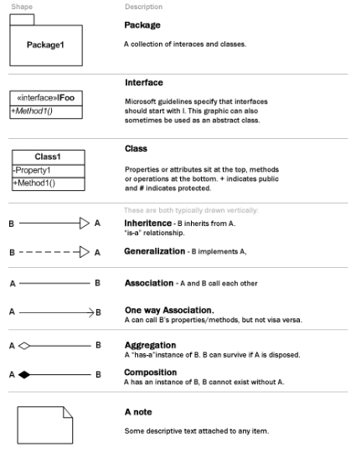
UML Cheat Sheet

Slide 6
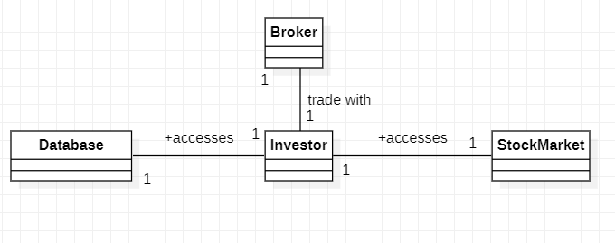
Object class

Slide 7
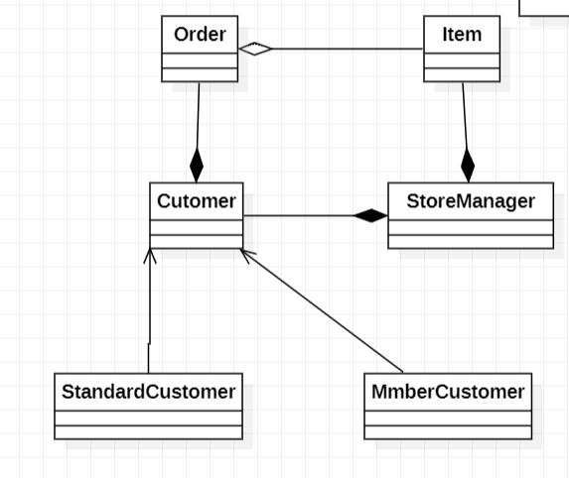

Slide 8
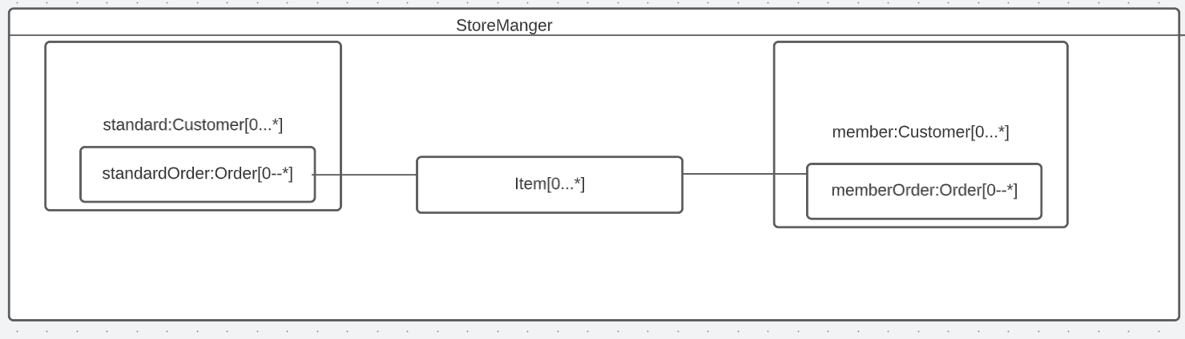
Composit Diagram
A good approach to describe the aggregations

Slide 9
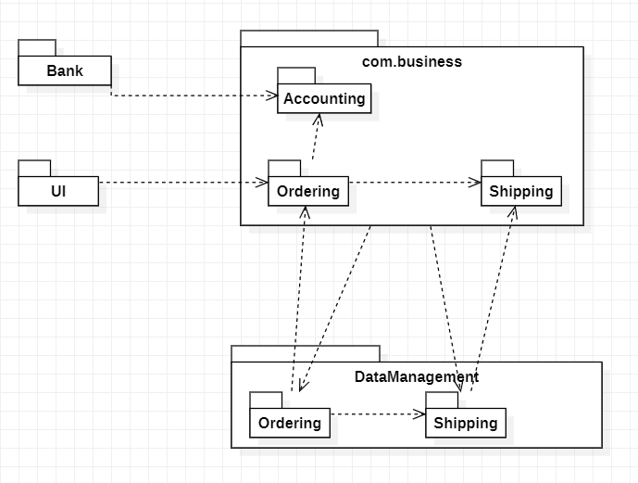
Package Diagram
Dependency

Slide 10
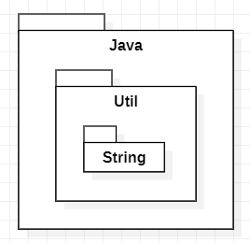
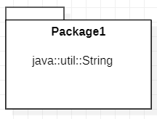
Package
OR

Slide 11
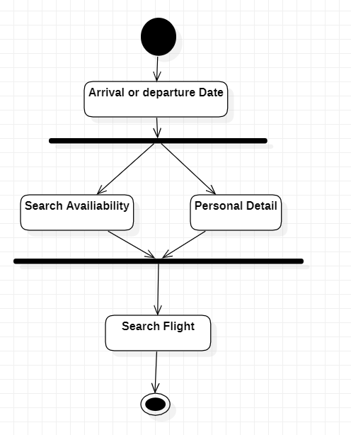
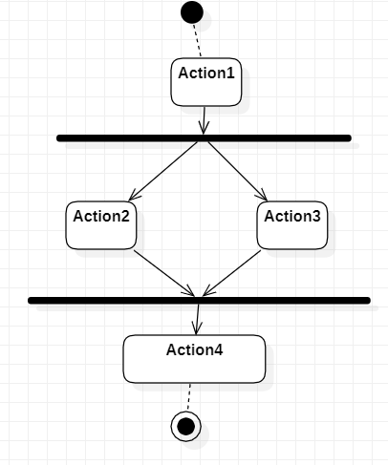
Activity Diagram

Slide 12
Use Case Diagram
Type of use case description
High level- A general description:
Expanded (detailed)-step by step
Essential-free of technological detail
Real-adds technological detail

Slide 13
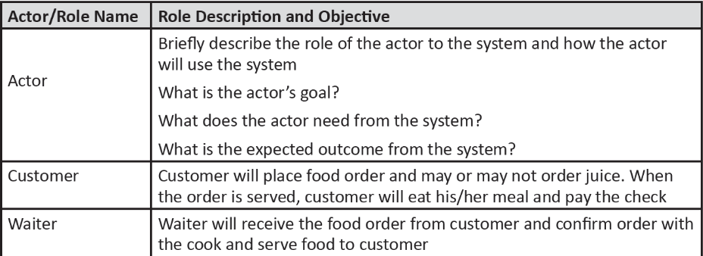
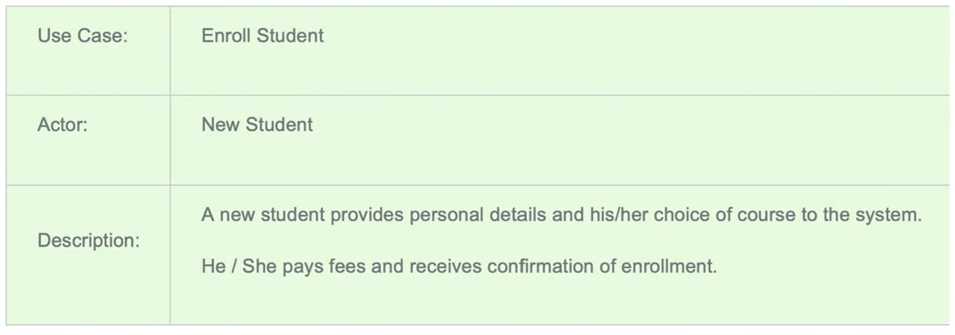
High-level of use case description
http://mohamedelgendy.com/blog/how-to-write-a-use-case-document.html

Slide 14
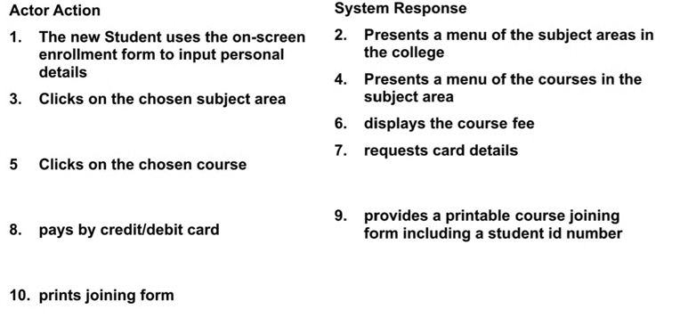
Expanded (detailed)-step by step
Enroll to a course

Slide 15
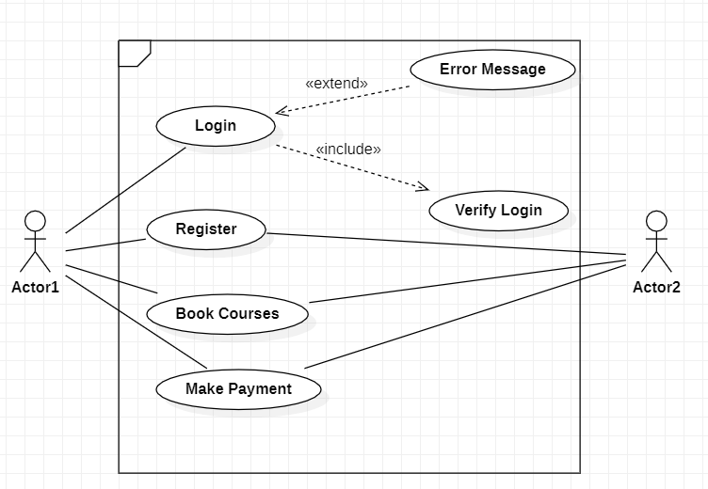
Use Case diagram

Slide 16

State Machine

Slide 17
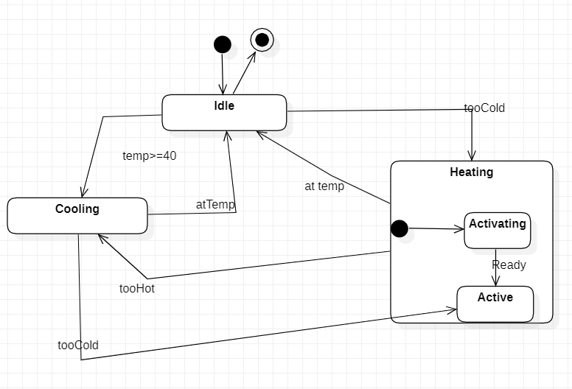
State Machine Diagram

Slide 18
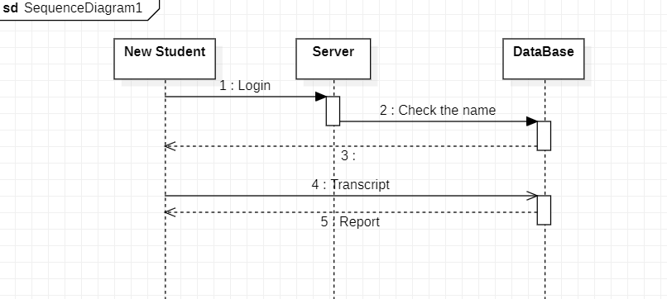
Sequence Diagram

Slide 19
Sequence Diagram 2

Slide 20
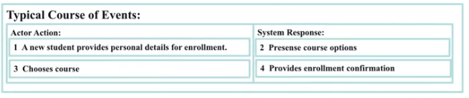
Sequence Diagram
Identified none for classes
Student
Course
Enrollment
We have to define the screen interaction between the use cases

Slide 21
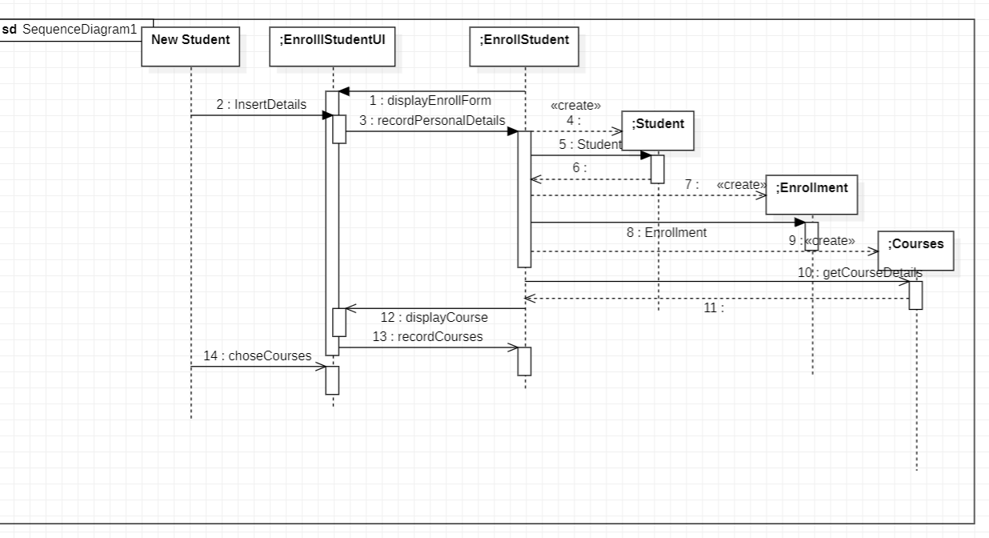
Identify the domain classes
Control Object life

Slide 22
EXAMPLE UML
https://www.uml-diagrams.org/examples/online-shopping-example.html

Slide 23
EXERCISE 1
Propose a use case diagram for an ATM machine for withdrawing cash. Make the use case simple yet informative; only include the major features.

Slide 24
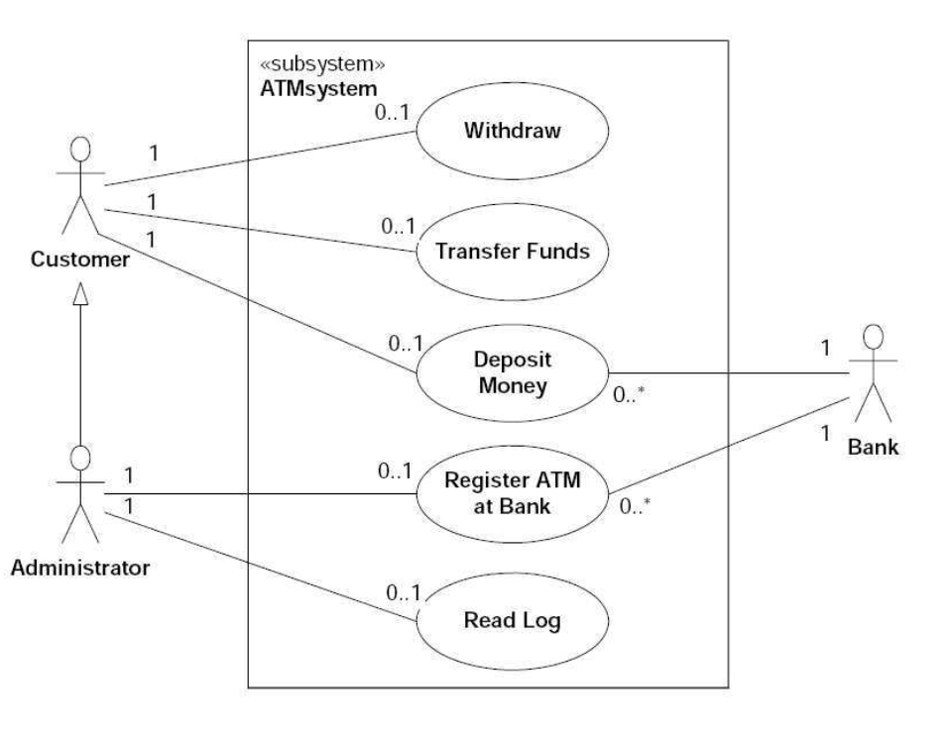
Solution

Slide 25
Exercise II
Propose a use case diagram for a vending machine that sells beverages and snacks. Make use of inclusion and extension associations, mark multiplicities, and remember that a vending machine may need technical assistance from time to time

Slide 26
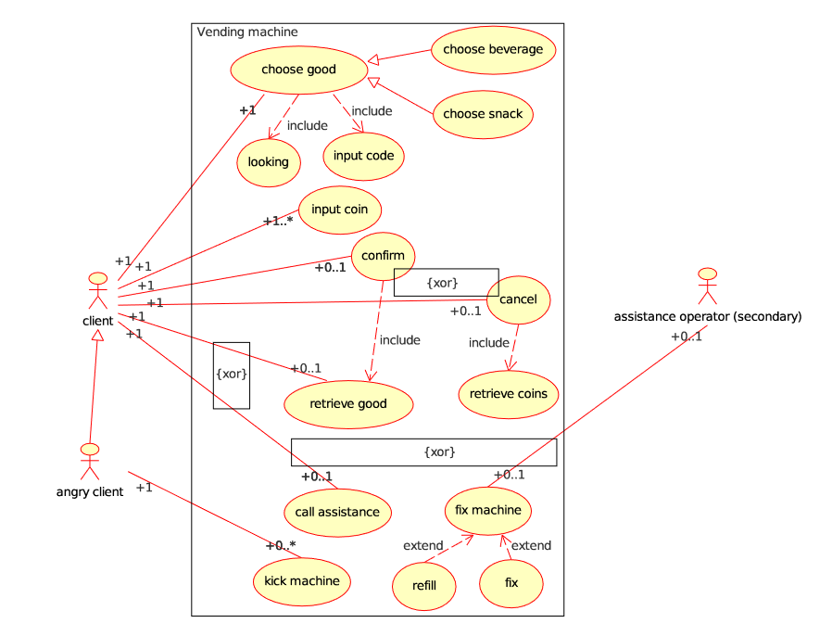
Solution

